Slide 1
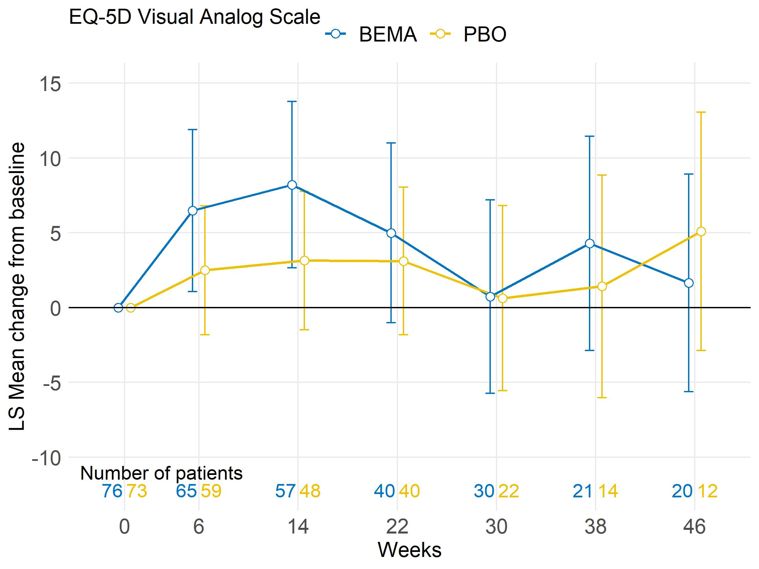
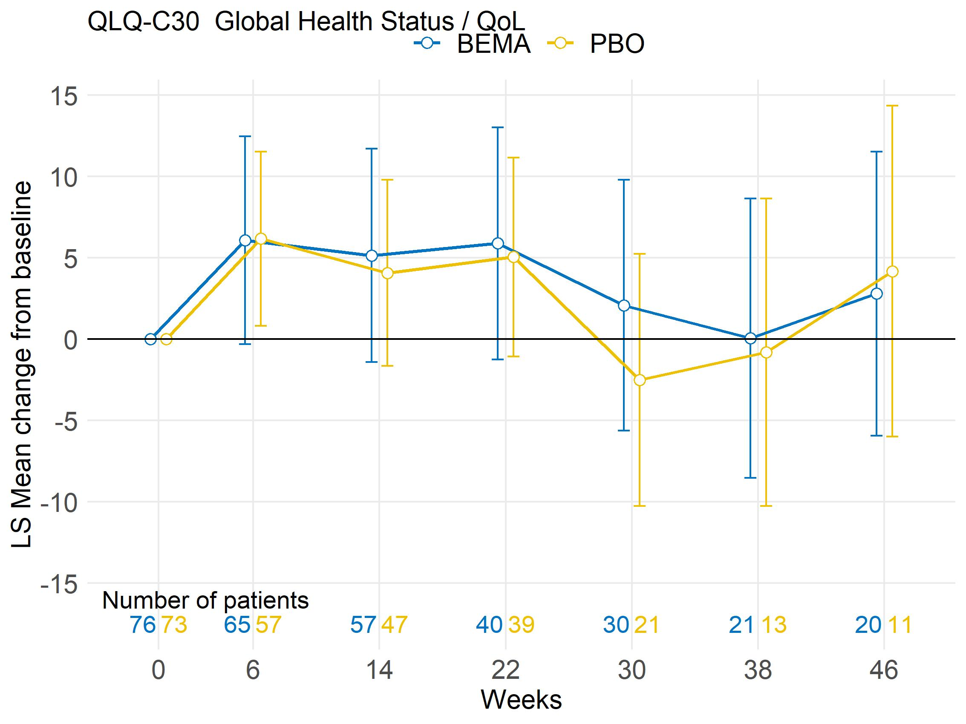
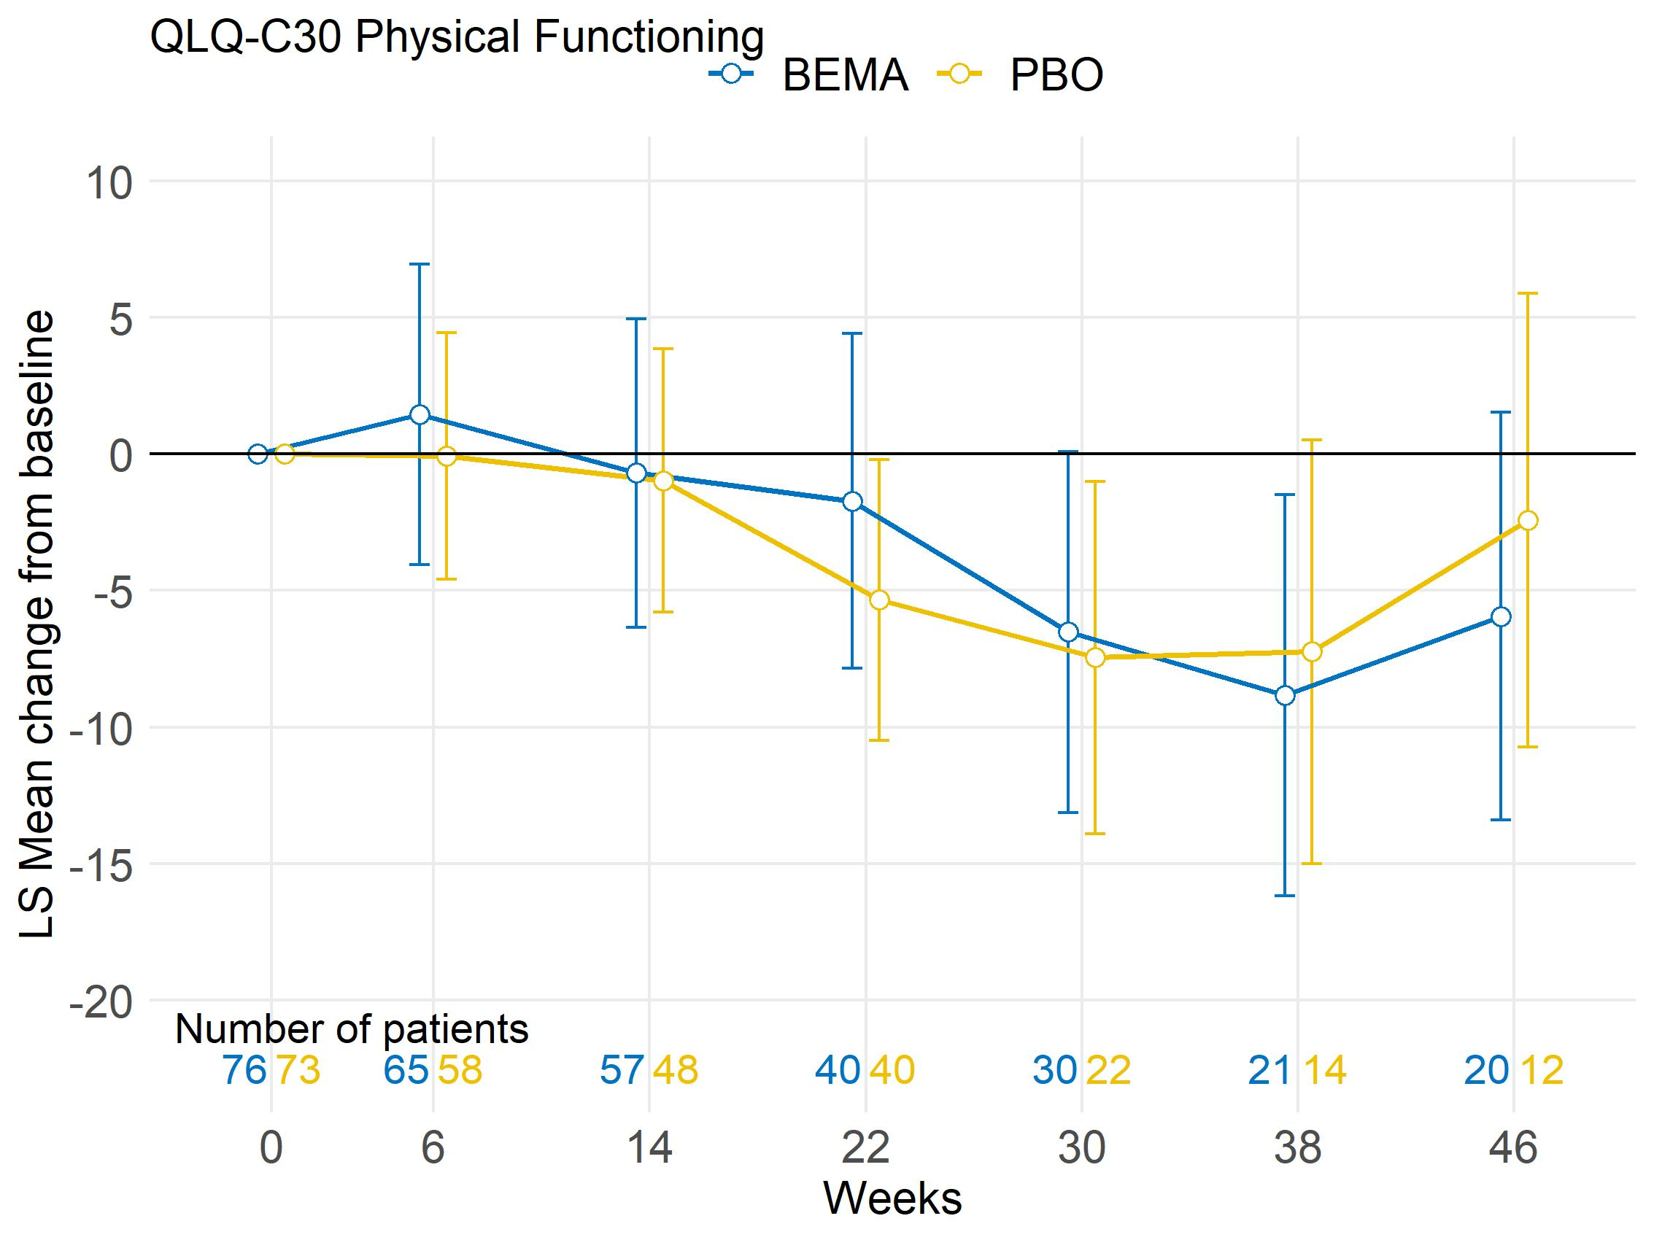
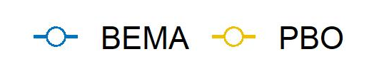
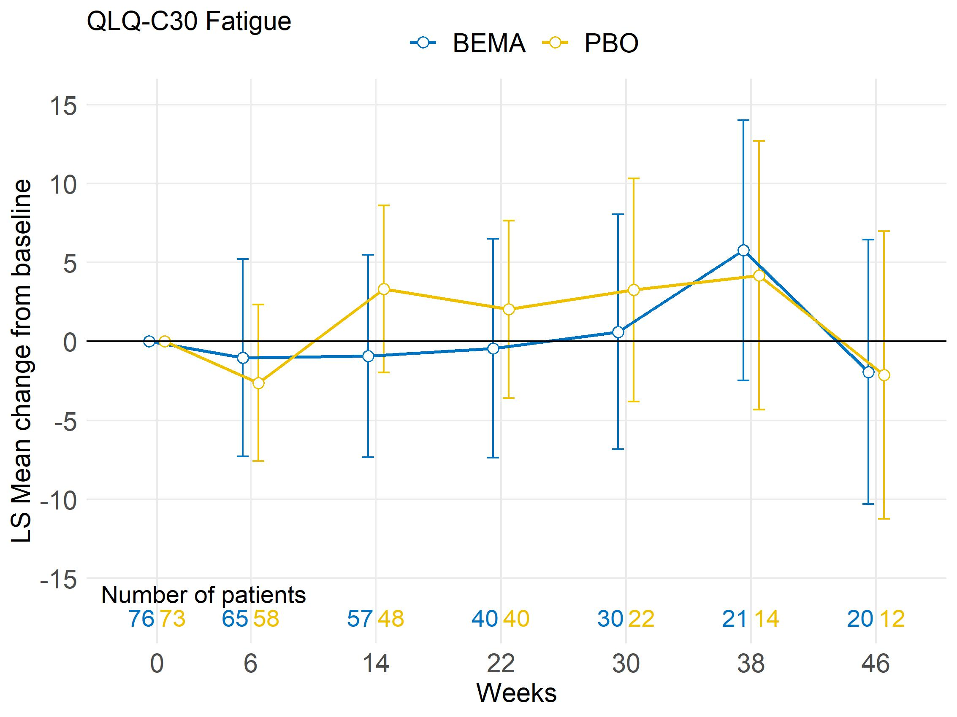
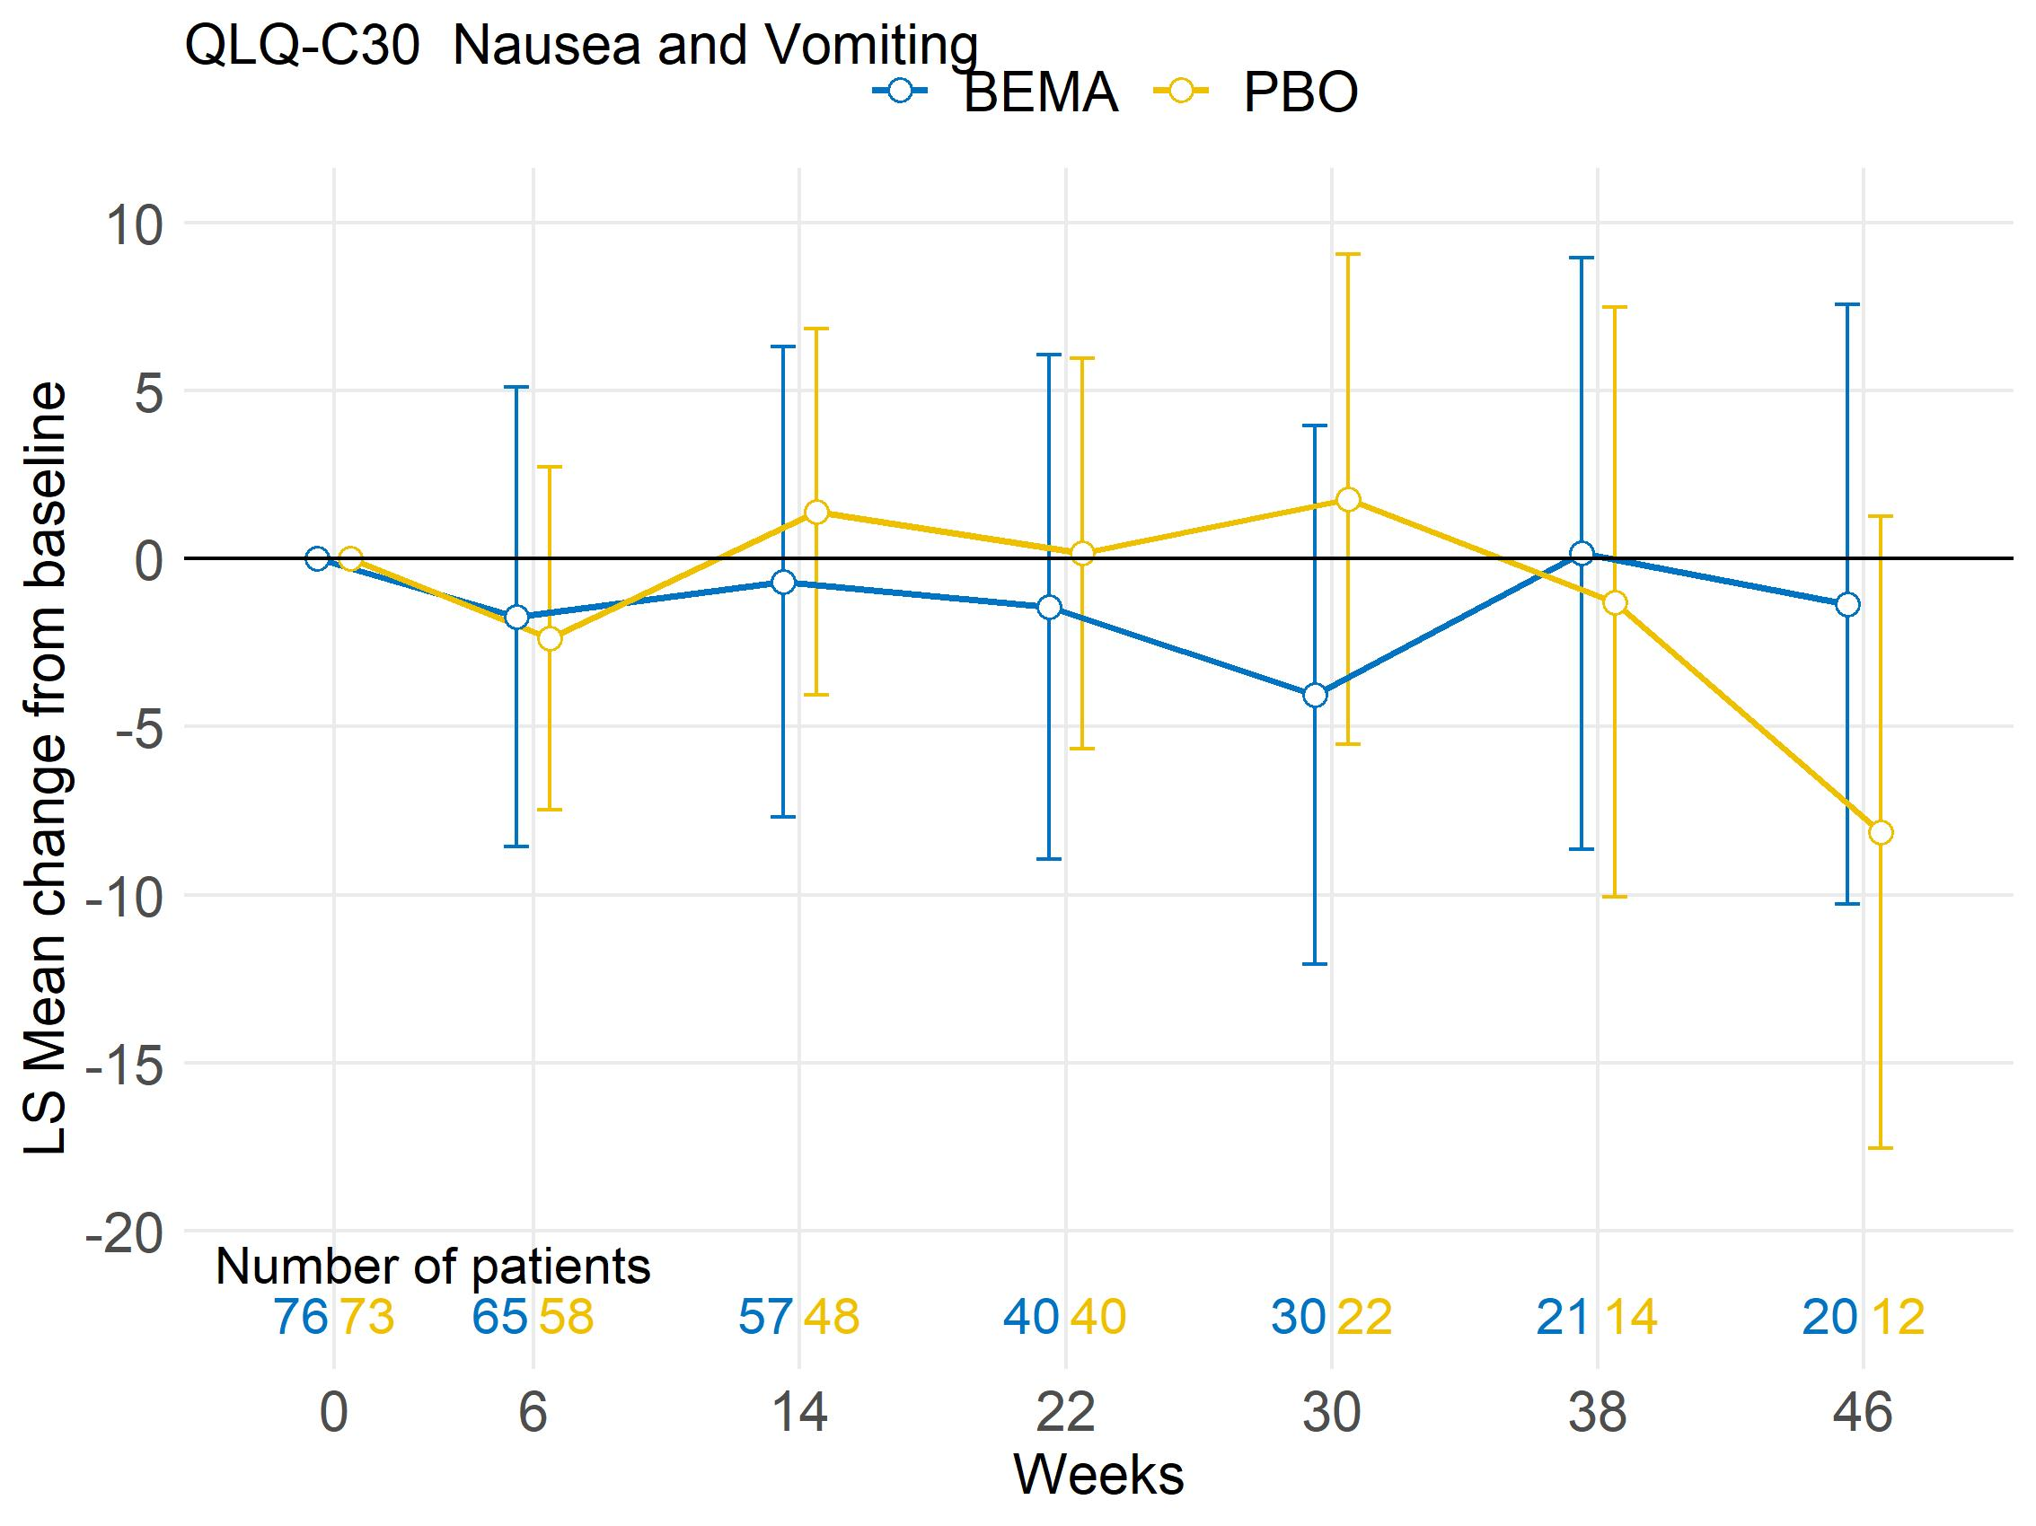
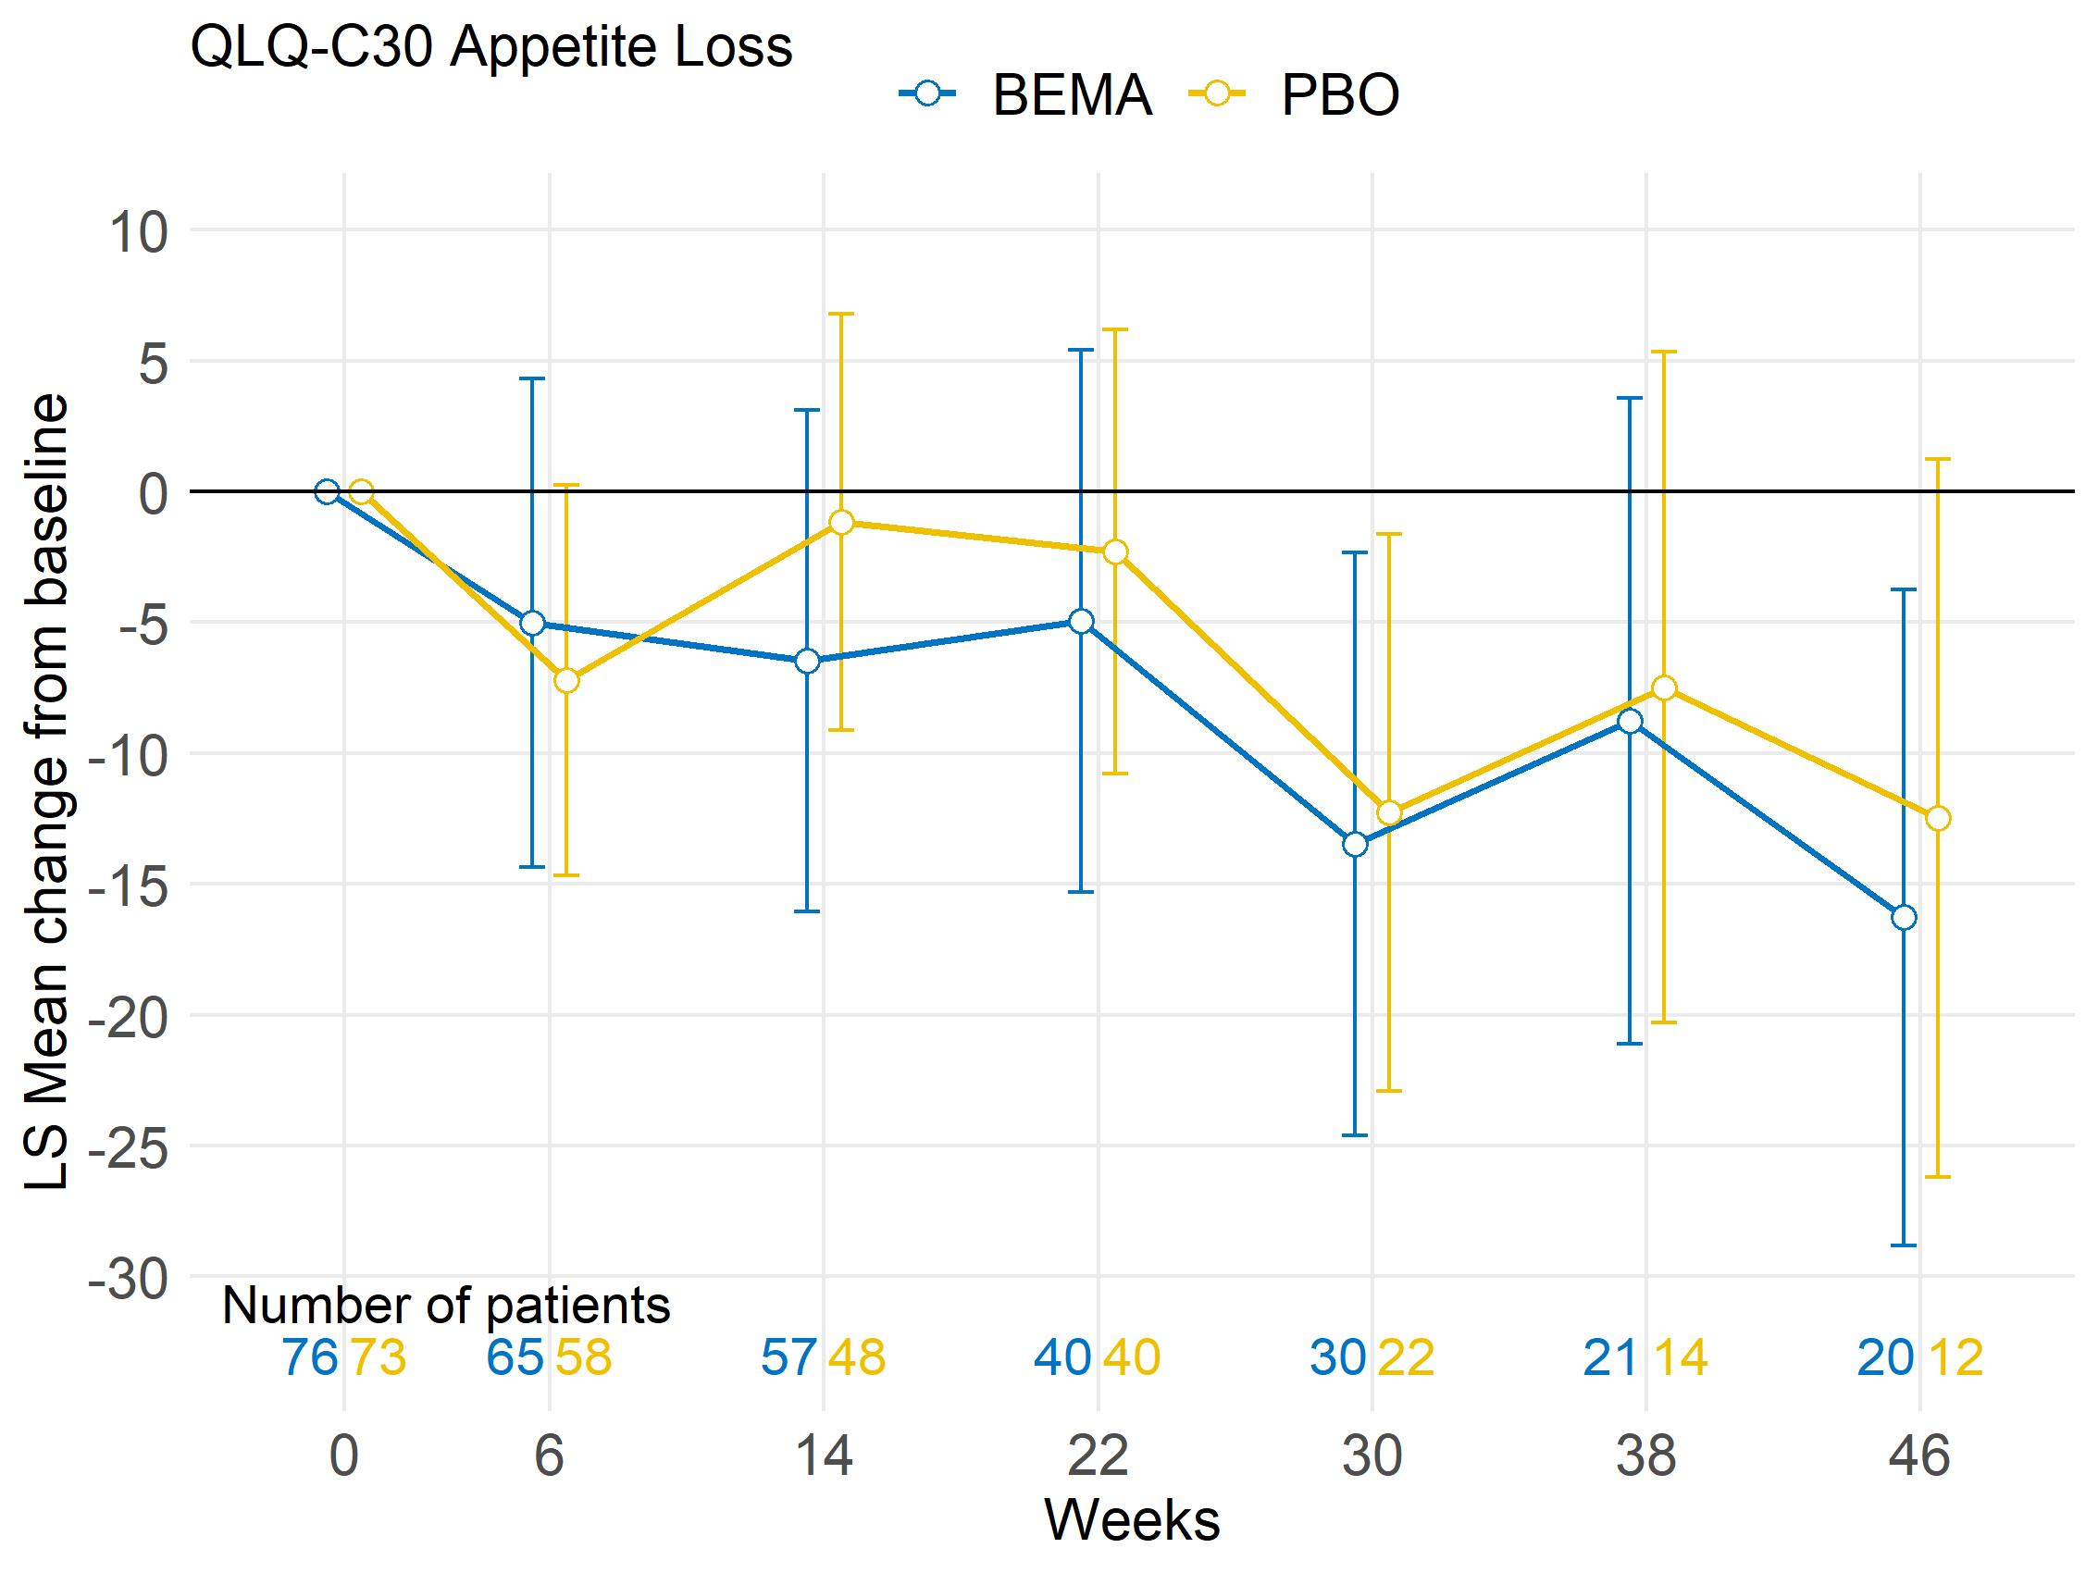
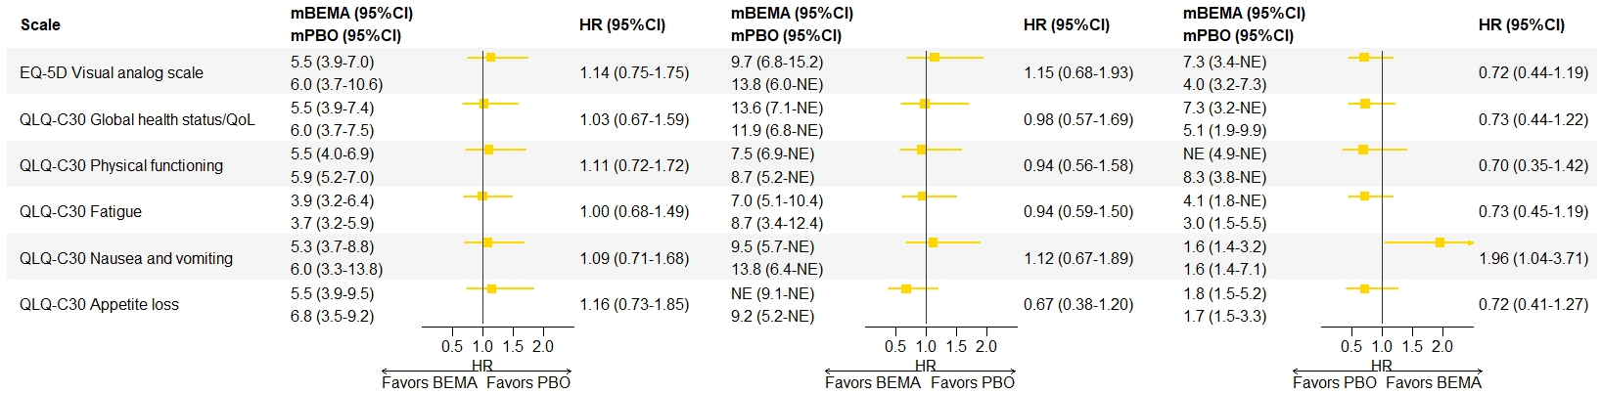

1221P
Health-related Quality of Life (HRQoL) in FGFR2b-Overexpressing, Advanced Gastric or Gastroesophageal Junction Cancer (G/GEJC):
Results From the FIGHT Trial Comparing Bemarituzumab (BEMA) + Modified FOLFOX6 (mFOLFOX6) to Placebo (PBO) + mFOLFOX6
Z. Wainberg¹, P. Enzinger², S. Qin³, K. Yamaguchi⁴, A. Gnanasakthy⁵, A. Jamotte⁶, I. Majer⁶, Y.-K. Kang⁷
¹Medicine Hematology and Oncology, University of California at Los Angeles, Los Angeles, CA, Los Angeles, USA; ²Gastrointestinal Cancer Center, Dana Farber Cancer Institute, Boston, MA, USA; ³Medical Oncology, Jingling Hospital, Nanjing University of Chinese Medicine, Nanjing, China;
⁴Gastroenterological Chemotherapy Dept., The Cancer Institute Hospital of JFCR, Koto-ku, Japan; ⁵Patient-CenteredOutcomes Assessment, RTI Health Solutions, Durham, NC, USA; ⁶Global HEOR, Amgen, Rotkreuz, Switzerland; ⁷Oncology Dept, Asan Medical Center, University of Ulsan College of Medicine, Seoul, Korea, Republic of Korea
BACKGROUND
RESULTS
STRENGTHS AND LIMITATIONS
Patients with advanced gastric cancer have a dismal prognosis with low survival rates and substantial symptom burden including weight loss, pain, dysphagia, nausea/vomiting and fatigue.^{1,2} About 30% of patients overexpress the fibroblast growth factor receptor 2b (FGFR2b) protein, an emerging biomarker and investigational target in gastric cancer.³
FIGHT (NCT03694522) is a phase 2, randomized, double-blind study evaluating bemarituzumab (BEMA), a monoclonal antibody targeting FGFR2b, plus modified FOLFOX6 (mFOLFOX6) chemotherapy versus placebo plus chemotherapy in previously untreated patients with advanced gastric or gastroesophageal junction cancer (G/GEJC) with confirmed FGFR2b overexpression. At the primary analysis (data cutoff [DCO] September 2020), BEMA/mFOLFOX6 demonstrated improved progression-free survival (PFS) vs placebo/mFOLFOX6 (median PFS 9.5 vs 7.4 months, hazard ratio [HR]: 0.68; 95% confidence interval [CI]: 0.44–1.04). At an updated analysis (DCO February 2021), the median overall survival (OS) was 19.2 vs 13.5 months, respectively (HR: 0.60; 95% CI: 0.38–0.94).⁴
Table 1. PRO instrument compliance and on-treatment attrition
Figure 1. LS Mean changes from baseline (95% CI)
Strengths
This is the first analysis that explored HRQoL in patients with advanced G/GEJC presenting with FGFR2b overexpression using well-validated and commonly used PRO instruments. It is also the first analysis that assessed the impact on HRQoL of adding BEMA to chemotherapy as a first-line treatment in advanced G/GEJC.
FIGHT is a double-blind controlled trial, which limits the impact of the placebo effect on HRQoL questionnaires. It enrolled subjects from around the globe, allowing to capture the perspective of patients from different geographies.
Limitations
FIGHT was not powered to investigate a difference in HRQoL between the two treatment arms. The analyses presented here were performed as exploratory post-hoc analyses and are based on limited sample size. Thus, these analyses are not meant to be used to draw definitive conclusions on the impact of BEMA on HRQoL.
 | Completion of PRO instruments (Number and % of scheduled PRO administration)
 | All subjects (N=155) |  | BEMA arm (N=77) |  | PBO arm (N=78)
Visit | N | % | N | % | N | %
Baseline | 151 | 97% | 76 | 99% | 75 | 96%
After 6 weeks | 128 | 96% | 65 | 94% | 63 | 97%
After 14 weeks | 108 | 95% | 57 | 98% | 51 | 91%
After 22 weeks | 81 | 94% | 40 | 95% | 41 | 93%
After 30 weeks | 53 | 95% | 30 | 97% | 23 | 92%
After 38 weeks | 36 | 95% | 21 | 95% | 15 | 94%
After 46 weeks | 32 | 97% | 20 | 100% | 12 | 92%
Beyond 46 weeks* | 48 | 95% | 27 | 94% | 21 | 96%
End of treatment | 82 | 60% | 43 | 65% | 39 | 56%
EQ-5D Visual Analog Scale
QLQ-C30 Global Health Status / QoL
QLQ-C30 Physical Functioning
Improvement
Improvement
Improvement
Deterioration
Deterioration
Deterioration
OBJECTIVE
The objective of this analysis was to assess the impact of adding BEMA to chemotherapy on health-related quality of life (HRQoL) based on the patient reported outcome (PRO) measures included in the FIGHT study.
QLQ-C30 Fatigue
QLQ-C30 Nausea and Vomiting
QLQ-C30 Appetite Loss
CONCLUSIONS
METHODS
Deterioration
Deterioration
In FIGHT, the addition of BEMA to backbone chemotherapy (mFOLFOX6) suggests a potential improvement in clinical outcomes, with no deterioration in HRQoL compared to chemotherapy alone.
HRQoL will be further evaluated in the ongoing confirmatory phase 3 FORTITUDE-101 trial (NCT05052801), which includes the EORTC QLQ-STO22 questionnaire specific to gastric cancer, in addition to the EORTC QLQ-C30 and EQ-5D-5L questionnaires.
Deterioration
PRO instruments and administration frequency
FIGHT included 2 PRO questionnaires: the European Organisation for the Research and Treatment of Cancer Quality of Life Questionnaire C30 (EORTC QLQ-C30)⁵ and the EuroQol EQ-5D-5L.⁶
PRO questionnaires were administered at screening, prior to receiving study drug, after 6 weeks and every 8 weeks thereafter until treatment discontinuation, with a last visit 28 days after the end of treatment.
Statistical analysis
Analyses were post-hoc exploratory analyses performed on the intention to treat (ITT) population using data from the February 2021 DCO date.
Completion rates at each study visit were defined as the % of subjects completing PRO assessments relative to all subjects with a scheduled visit.
The following PRO endpoints were assessed:
  Least squares (LS) mean change from baseline, estimated using mixed models with repeated measures including randomization factors, study visit, treatment arm and visit-by-treatment interactions as covariates.
  Time to deterioration/improvement, defined as the time until first PRO visit with a decrease/increase in score from baseline greater than the minimal clinically important difference (MCID), or death if occurring within 12 weeks of the last PRO visit.
  Time to sustained deterioration, defined similarly to time to deterioration but requiring a second PRO visit with deterioration from baseline greater than the MCID or death within 12 weeks of the first deterioration.
  Time to event analyses were conducted using Cox models adjusting for randomization factors and treatment. Subjects who could not deteriorate/improve because of too high/low scores at baseline for a given scale were excluded from the analyses for that scale.
  The MCID was defined as a within-subject change of 10 points for the EORTC QLQ-C30 and 7 points for EQ-5D VAS questionnaire.^{7,8}
Of the available scales of the EORTC QLQ-C30 questionnaire, the results presented here focus on the scales that were considered most important and directly relevant to gastric cancer patients.
*Subsequent visits were aggregated in this table due to low patient numbers.
Improvement
Improvement
PRO compliance
76 subjects (99%) in the BEMA arm and 75 subjects in the PBO arm (96%) completed both QLQ‑C30 and EQ-5D-5L questionnaires at baseline.
PRO questionnaire completion rates remained high over time (>90% across all visits) in both treatment arms while subjects were on treatment. Subjects in the BEMA arm had numerically higher completion rates for most visits (Table 1).
Mean change from baseline
LS mean change from baseline analyses suggested that patients’ PRO scores were similar over time in the two study arms. Of note, there were numerical improvements in scores at week 6 in both treatment arms across scales (e.g., appetite loss, global health status/QoL) (Figure 1).
Time to deterioration/improvement
Analyses of the time to deterioration, time to sustained deterioration, and time to improvement corroborated the finding that HRQoL was similar across the two arms (Figure 2).
  The estimated HRs for time to deterioration varied between 0.78 (emotional functioning scale) and 1.17 (pain scale), all of them with a 95% CI including 1.00.
  HRs for time to sustained deterioration (HRs varied between 0.67 and 1.15) and time to improvement (HRs varied between 0.70 and 1.96) were in line with those for time to deterioration suggesting no meaningful difference across treatment arms.
Improvement
BEMA, bemarituzumab; LS, least square; PBO, placebo; QoL, Quality of Life; QLQ-C30, Quality of Life Questionnaire C30.
REFERENCES
Figure 2. Time to deterioration, sustained deterioration and improvement
https://seer.cancer.gov/statfacts/html/stomach.html; 2022.
https://www.cancer.org/cancer/stomach-cancer/detection-diagnosis-staging/signs-symptoms.html; 2021.
Wainberg ZA, et al. ASCO Gastrointestinal Cancer Symposium; January 15-16, 2021; Abstract LBA160 and oral presentation.
Catenacci DVT, et al. Journal of Clinical Oncology; 2021;39(15_suppl): 4010.
Aaronson NK, et al. J National Cancer Inst. 1993;85: 365-376.
Rabin R, et al. Annals of Med. 2001;33:337-343.
Pickard AS, et al. Health Qual Life Outcomes. 2007;5:70 [correction 2010;8:4].
Cocks K, et al. European Journal of Cancer. 2008;44(13):1793-8.
Time to Deterioration
Time to Sustained Deterioration
Time to Improvement
ACKNOWLEDGEMENTS / DISCLOSURES
This study has been funded by Amgen Inc. (NCT03694522).
Medical writing support for this poster was funded by Amgen Inc. and was provided by Sahishnu Patel.
Dr. Wainberg reports consulting or advisory roles at Amgen, Array BioPharma, AstraZeneca/MedImmune, Bayer, Bristol-Myers Squibb, Daiichi Sankyo/Astra Zeneca, Five Prime Therapeutics, Ipsen; Lilly, Macrogenics, Merck, Merck KGaA, Novarti, and QED Therapeutics, as well as research funding from Five Prime Therapeutics, Merck, Novartis, Pfizer, and Plexxikon.
Please scan the QR code to access the
e-version of this poster.
Note: Medians values are reported in months
HR, hazard ratio; mBEMA, median time to event in the BEMA arm; mPBO, median time to event in the PBO arm; QoL, Quality of Life.
Email: zwainberg@mednet.ucla.edu
European Society for Medical Oncology; Paris, France; September 9–13, 2022

